Slide 1
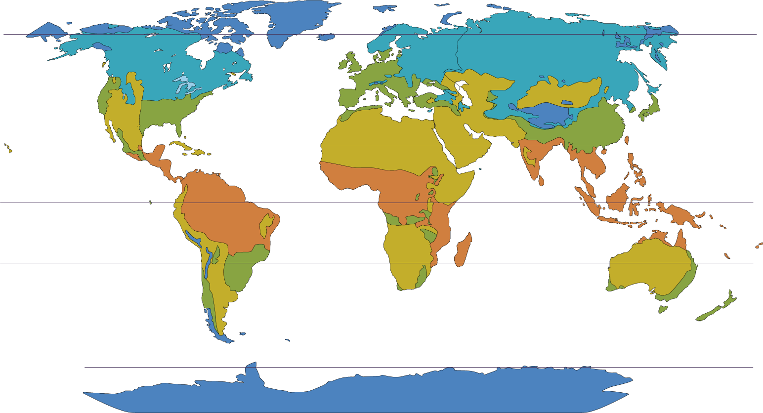
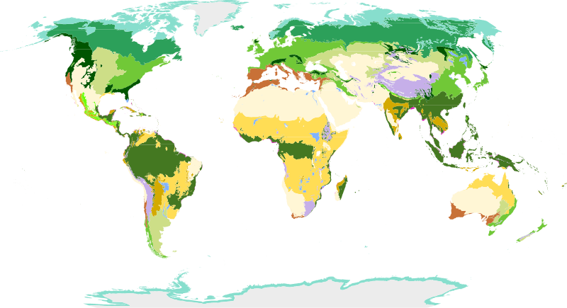
Introduction to global climate
Climate zones
Key Vocabulary
Climate zones are areas in the world that have a similar climate. There are several major climate zones in the world, and the main six are shown on this map. The climate zones generally group together horizontally, following lines of latitude.
greenhouse gases – gases such as carbon dioxide that trap heat within the atmosphere
the greenhouse effect – the natural warming of the planet to its habitable temperature, caused by trapping heat in the Earth’s atmosphere
the enhanced greenhouse effect – the unnatural warming of the Earth due to increased greenhouse gases in the atmosphere
global warming – the increase of average temperatures on Earth; this happens naturally but happens faster due to the enhanced greenhouse effect
climate change – the change in the Earth’s long-term weather patterns, including precipitation, wind and temperature
fossil fuel – a (chemical) store of energy formed over millions of years from dead plants and animals
tropical A
arid (dry) B
temperate C
continental D
polar E
Biomes
 | tundra
 | taiga
 | temperate forest
 | tropical rainforest
 | savanna grasslands
 | Mediterranean
 | hot deserts
 | cold deserts
 | alpine shrublands
Biomes are areas of the world that, because of similar climates, have similar landscapes and wildlife. Biomes are shown on the map.
Terpsichores, CC BY-SA 3.0,via Wikimedia Commons
Geography | 7.01: Introduction to map skills | Knowledge Organiser
Notes:
Images:
Biomes of the world (CC BY-SA 3.0) – https://commons.wikimedia.org/wiki/File:Biomes_of_the_world.svg
All other images – United Learning

Slide 2
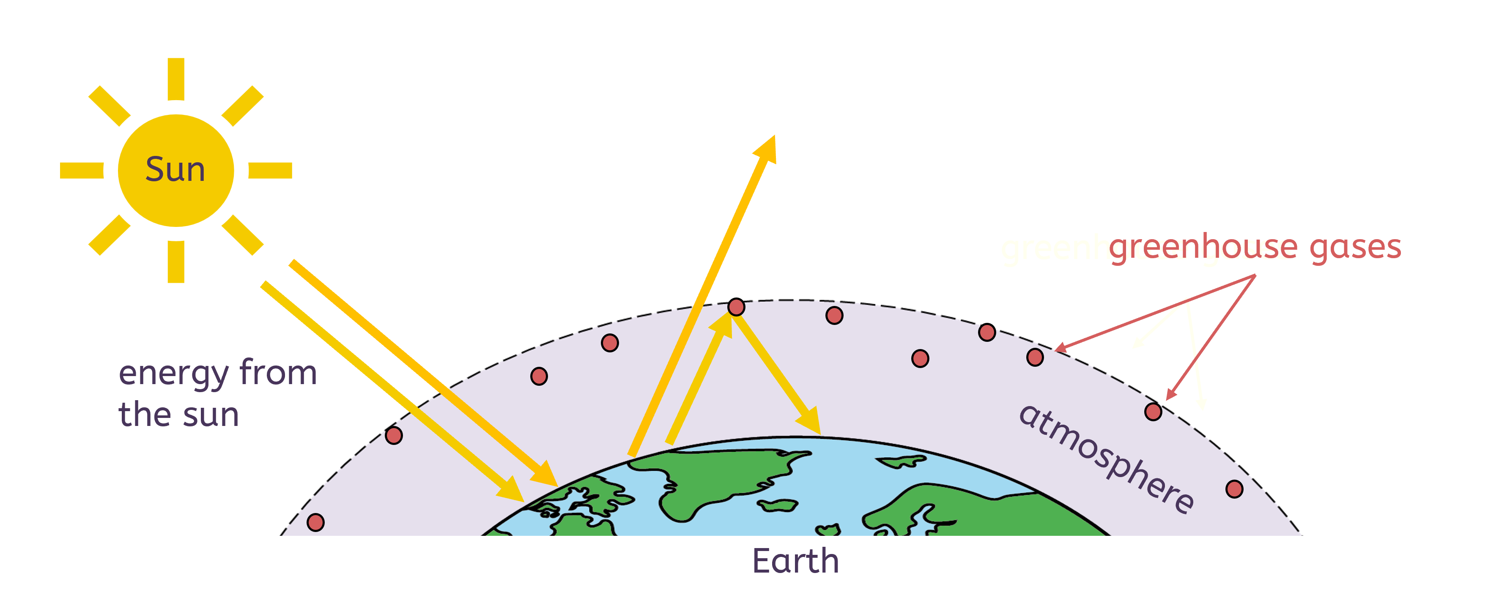
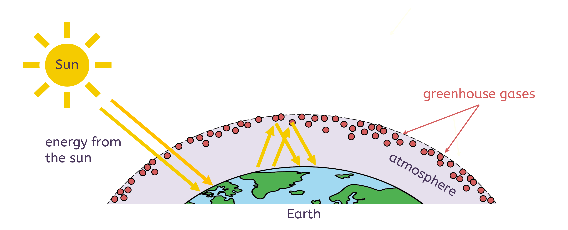
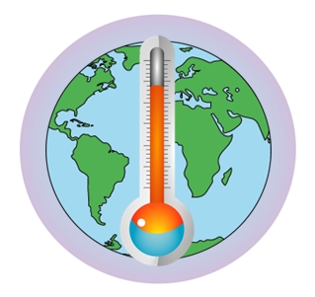

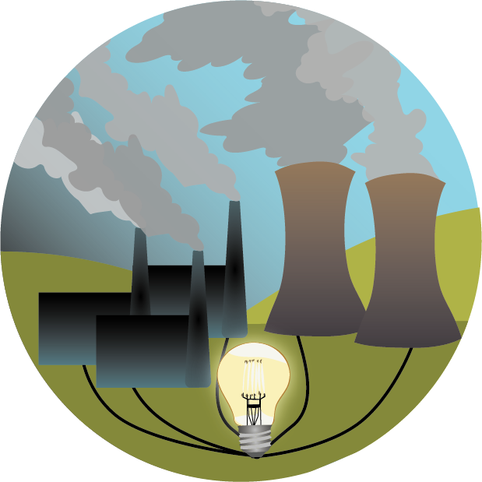
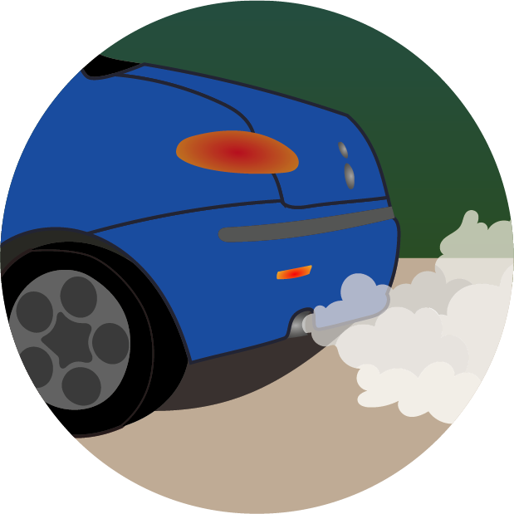
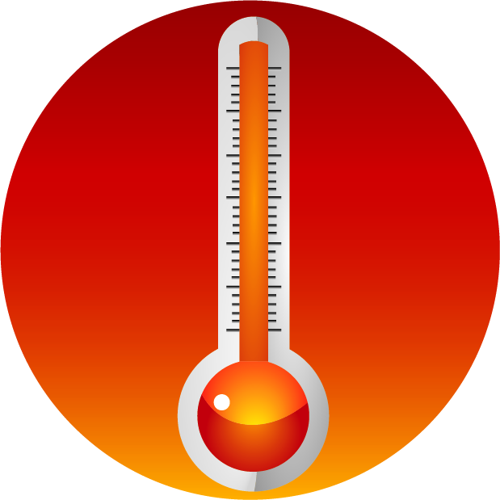
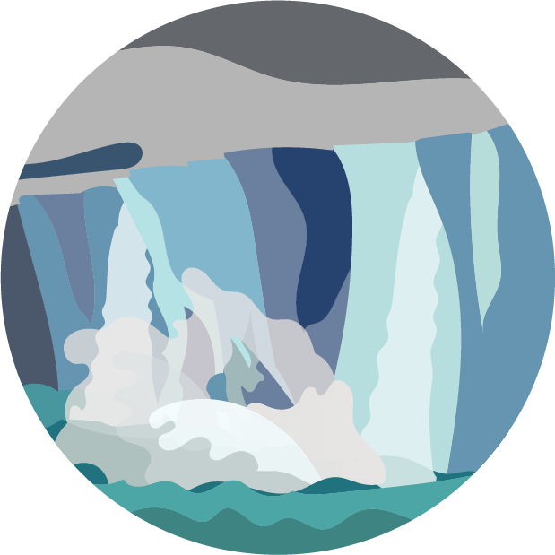


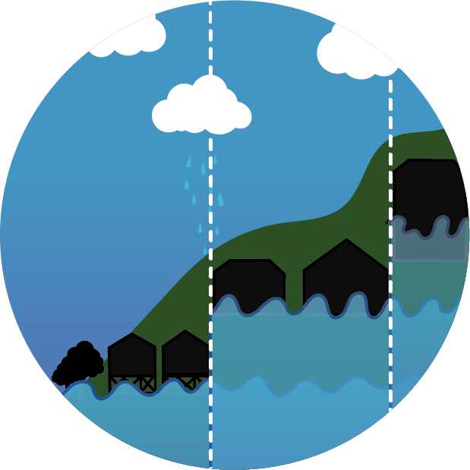
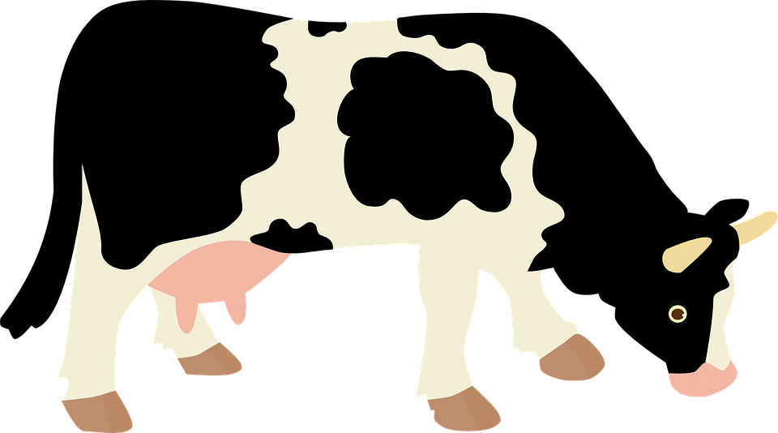
Introduction to global climate
Global warming
The greenhouse effect is the natural process, which has always taken place, that keeps the Earth warm. Without it, the Earth would be too cold to live on.
The light and heat energy are trapped in the atmosphere by greenhouse gases, such as carbon dioxide. This warms the Earth.
The enhanced greenhouse effect causes an unnatural increase in temperature. Human activities (such as burning fossil fuels, transport, waste, agriculture, deforestation) increase the amount of greenhouse gases in the atmosphere. The Earth warms more quickly, and global warming increases.
Accelerated global warming can also lead to other changes in the Earth’s long-term weather patterns, such as precipitation, wind and storms. The changes to the Earth’s wider climate – not just temperature – are called climate change.
The causes of climate change
The effects of climate change
Climate change is caused by:
burning fossil fuels for transport and electricity generation, which releases greenhouse gases
deforestation, which reduces the absorption of greenhouse gases
agriculture and waste disposal, which release greenhouse gases
Climate change can cause:
more extreme weather events, such as heatwaves
melting sea ice and ice caps
rising sea levels and flooding of coastal areas
deforestation
electricity generation
transport
agriculture
waste
Notes:
Images:
Cows (CC0) – from https://pixabay.com/vectors/cow-milk-tour-economy-animal-1204968/
All other images – United Learning

